Slide 1
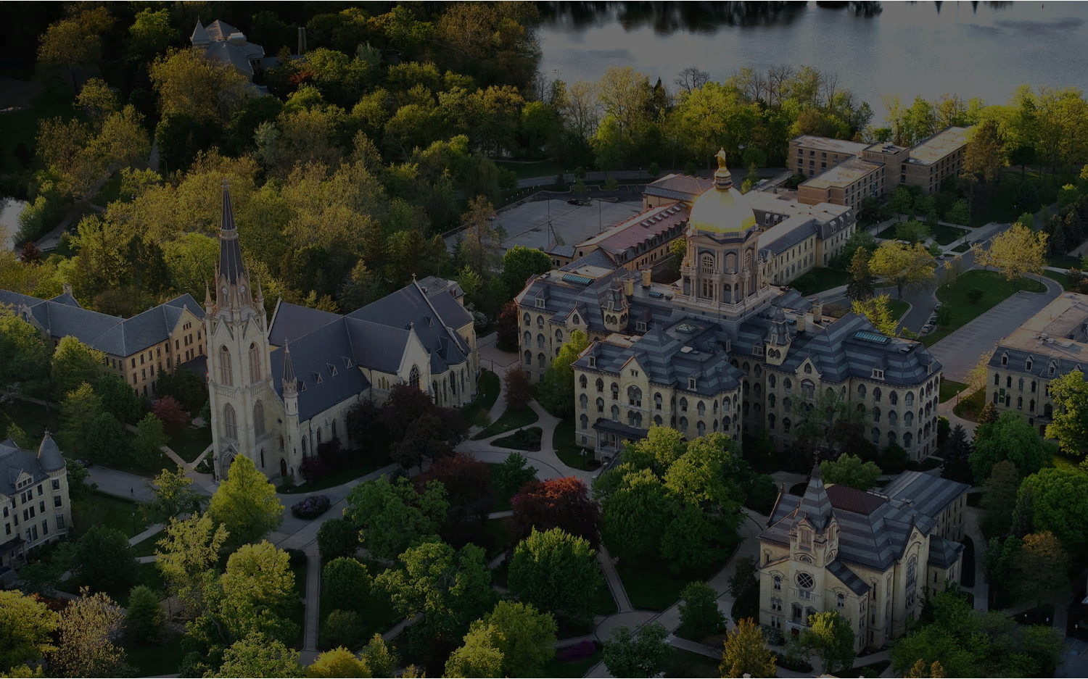
Data and Model Challenges in
AI for Material Property Prediction
and Inverse Design
Meng Jiang
Frank M. Freimann Collegiate Associate Professor
Department of Computer Science and Engineering
Director, Foundation Models and Applications Lab

Slide 2
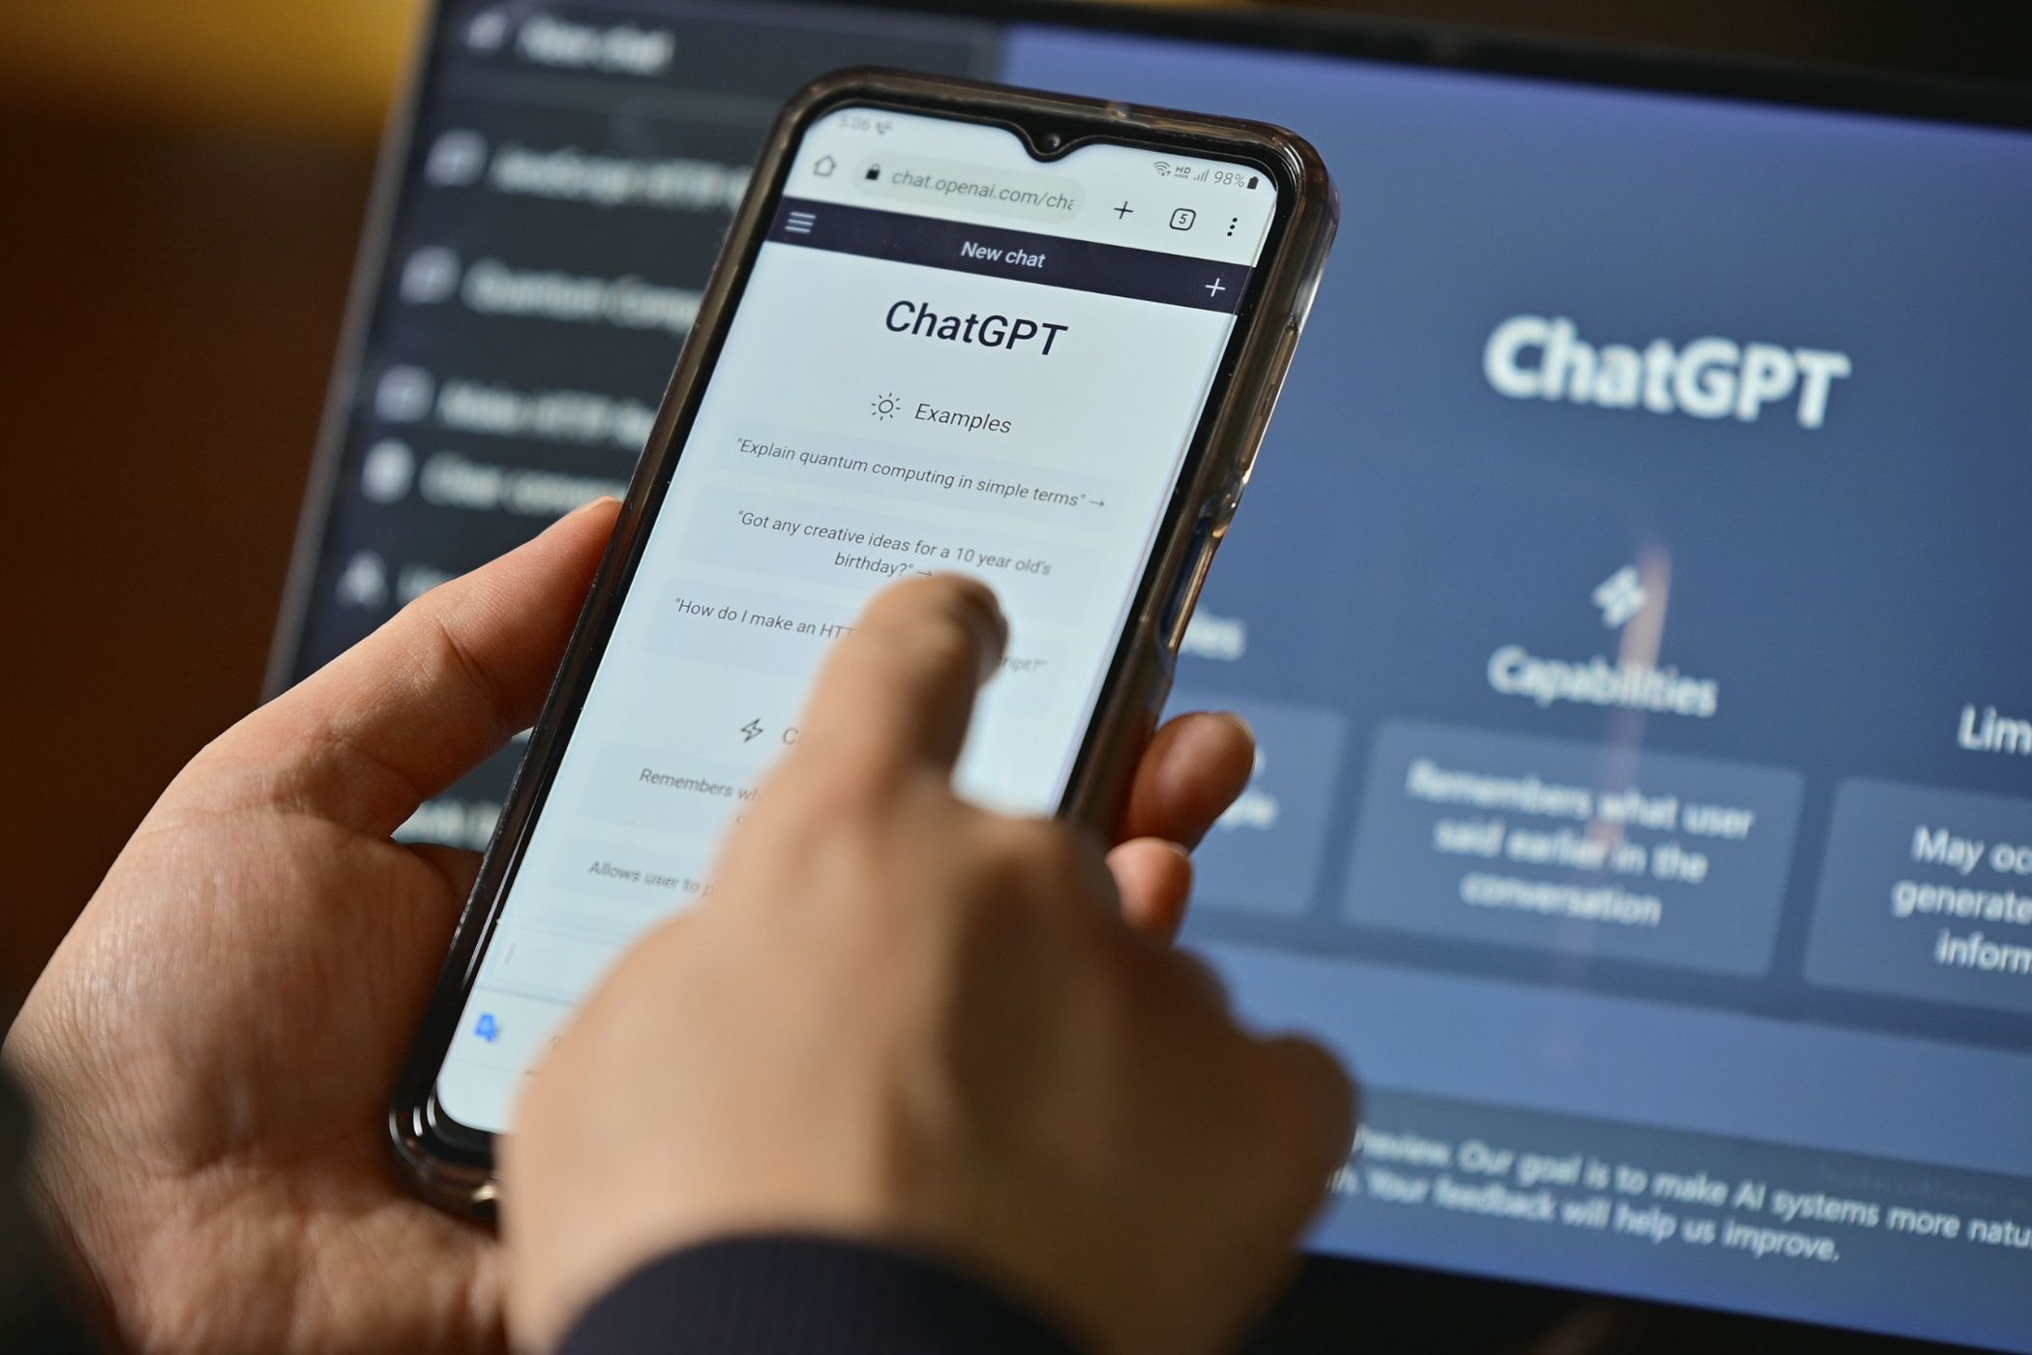
The Core of AI for X is Generalized Abilities
Observations
What are the biggest differences between ChatGPT and previous language models?
ChatGPT is a product that has 400 million weekly active users.
It takes a wide range of inputs from diverse users.
Its outputs may not be flawless but far from useless.
AI
Generalized Abilities
Unseen Distributions
Unseen Instances
Unseen Tasks

Slide 3
The Core of AI for X is Generalized Abilities
Observations
AI for Material Property Prediction
Predicting an unseen value of a seen property
Predicting an unseen property of a seen material
Predicting the property value of an unseen material of a seen type
AI
Predicting the property value of an unseen type of material
AI for Material Inverse Design
Generating a material of an unseen value of a seen property
Generalized Abilities
Generating a material of unseen values of multiple seen properties
Unseen Distributions
Unseen Instances
Unseen Tasks
Predicting the unseen synthesis method of a seen material
Predicting the synthesis method of an unseen material

Slide 4
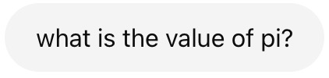
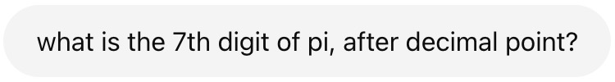
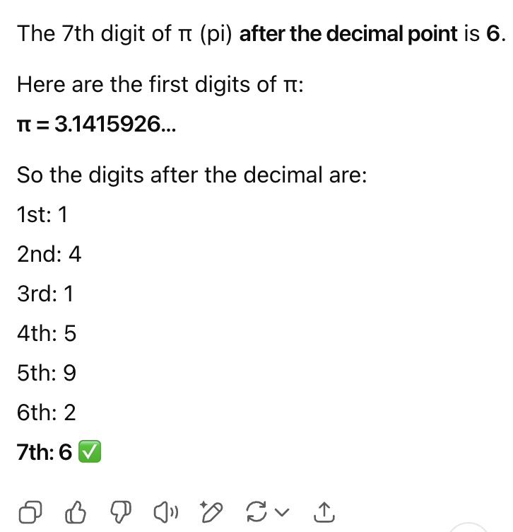
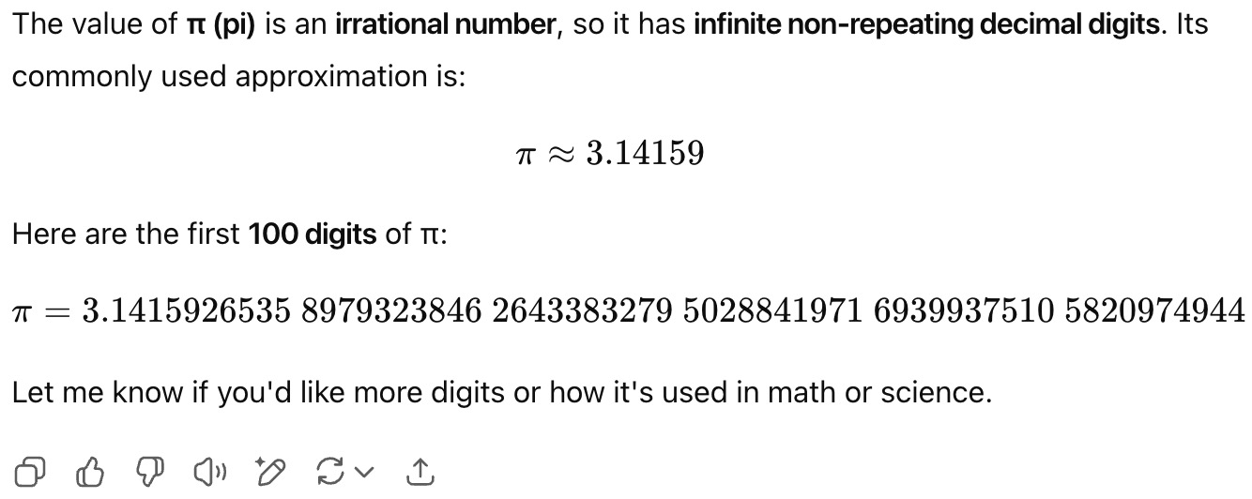
What are the Foundations of Generalized Abilities?
Suspect: Memorization, not Generalization?

Slide 5
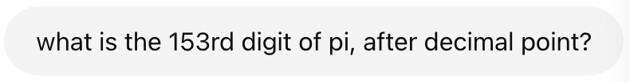
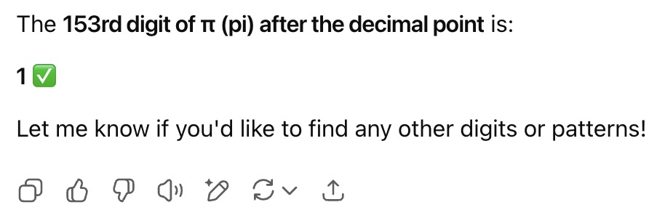
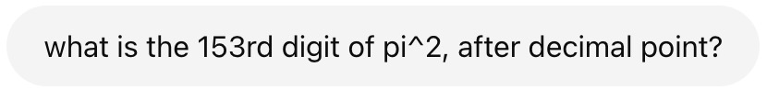
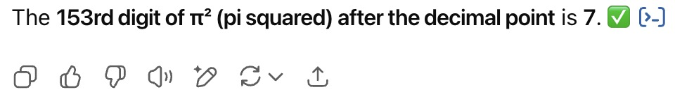
What are the Foundations of Generalized Abilities?
Suspect: Memorization, not Generalization?

Slide 6
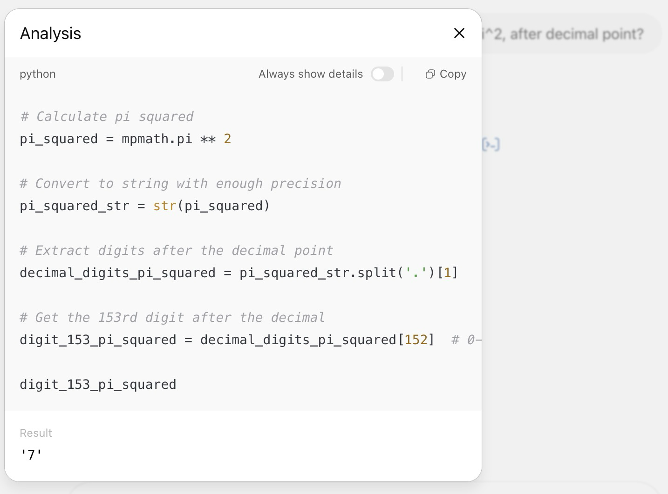
What are the Foundations of Generalized Abilities?
From Memorization to Knowledge and Reasoning:
as natural languages or programming languages: Language Models, etc.
as latent representations and/or projections: Graph Neural Networks, etc.

Slide 7
The Source of Knowledge (and Reasoning) is Data
Analyze data and write papers
Literature
(Data)
Wet-lab experiments
Simulations
Observations
(Data)
Data augmentation
Abstractive Knowledge ++
Text, charts, images, graphs
human intelligence
with generalization as an objective
Develop machine
learning models
Fingerprints
Random forests
Graph neural networks
Large language models
Rationalization
Data-driven Knowledge
(Model)
Generalized Abilities
(unseen instances and unseen tasks)
artificial intelligence
with generalization as an objective
Data Challenges: Narrowness and Scarcity
Model Challenges: Multimodality, Explainability, and Task generalization

Slide 8
What is Rationale in Supervised Learning?
Rationales and Environments
Rationale is defined as a subset of input features that best explains or supports the prediction by machine learning models.
Rationale identification improves the generalizability and interpretability of machine learning models on language and vision data.
Every time I order at the drive thru they make me park up and wait. Today I waited 20 mins and when my food arrived, it was stone cold.
negative
negative
I’ve just got home and one of my burgers was stone cold.
“Environments”
“Rationales”
I find that my French toast has a nice texture!
positive
Chocolate cake has a nice texture. I took a picture.
positive
Chang, et al. "Invariant rationalization." ICML, 2020.

Slide 9
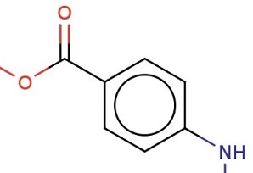
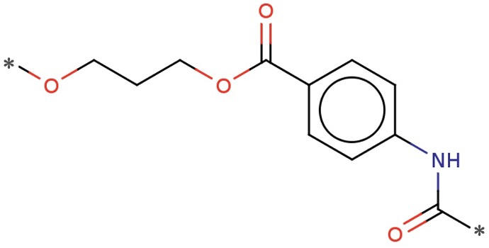
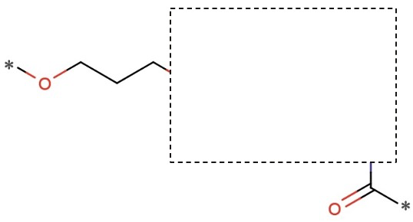
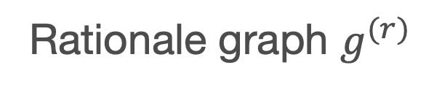
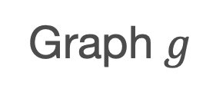
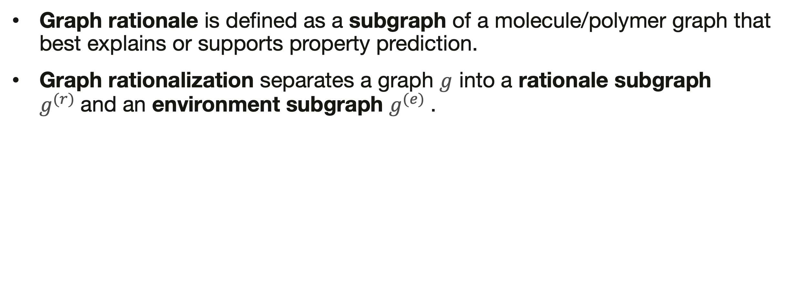
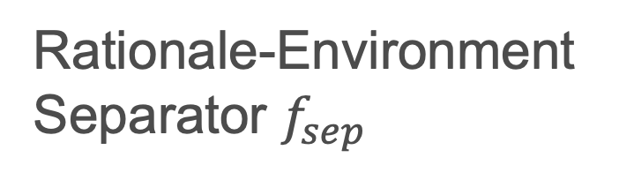
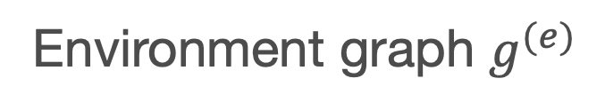
Graph Rationalization
Graph Rationales and Environments
Graph rationale is defined as a subgraph of a molecule/polymer graph that best explains or supports property prediction.
Graph rationalization separates a graph $g$ into a rationale subgraph $g^{(r)}$and an environment subgraph $g^{(e)}$.
Rationale-Environment Separator $f_{sep}$
Rationale graph $g^{(r)}$
Environment graph $g^{(e)}$
Graph $g$

Slide 10
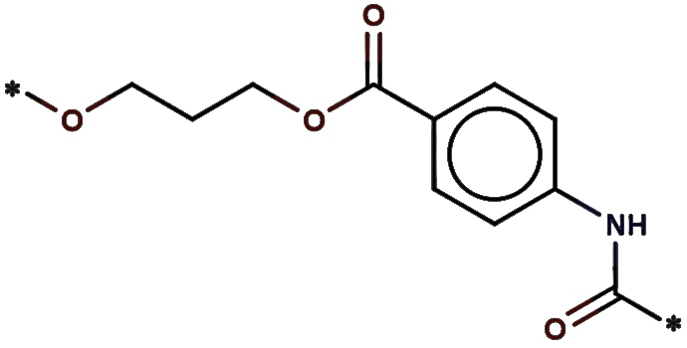

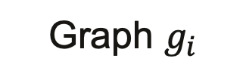
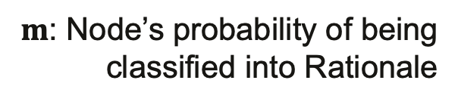
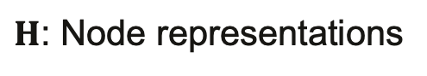
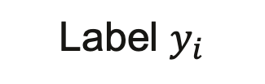
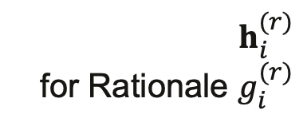
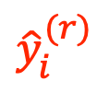
Baseline: Rationalization Improves Label Prediction
m: Identifying node roles，in Rationale or Environment
$$1_{N}^{⊤}⋅\left(m×H\right)$$
MLP₂(·)
$${\hat{y}}_{i}^{(r)}$$
Label $y_{i}$
GNN₁(·)
MLP₁(·)
…
$$h_{i}^{(r)}$$
for Rationale $g_{i}^{(r)}$
$m$: Node’s probability of being classified into Rationale
Graph $g_{i}$
GNN₂(·)
…
$H$: Node representations
A model trained on a small number of examples could not effectively capture rationales.

Slide 11
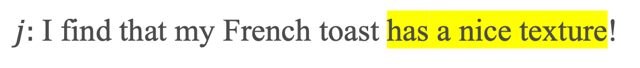
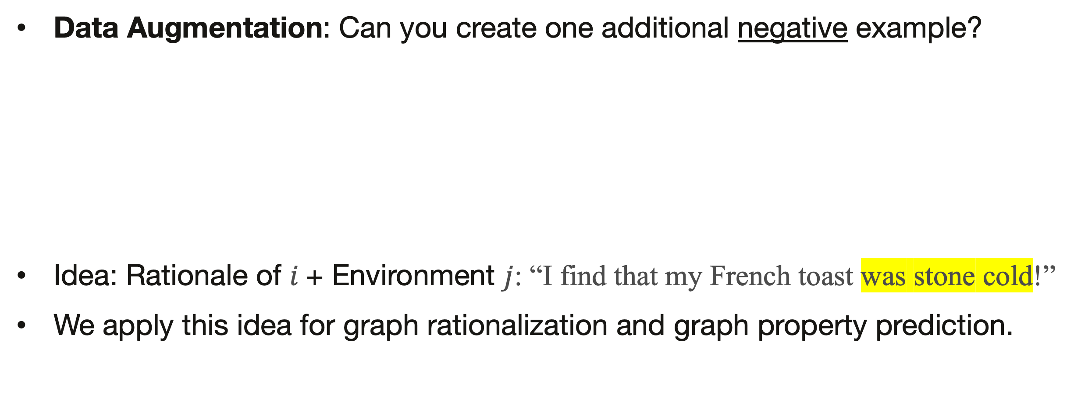
Creating More Data Examples for Rationalization
How: if Rationales are the key factors of Labels, then …
Data Augmentation: Can you create one additional negative example?
Idea: Rationale of $i$+ Environment $j$: “I find that my French toast was stone cold!”
We apply this idea for graph rationalization and graph property prediction.
negative
$i:$I’ve just got home and one of my burgers was stone cold.
“Environments”
“Rationales”
$j:$I find that my French toast has a nice texture!
positive

Slide 12
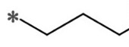
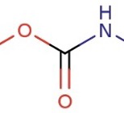
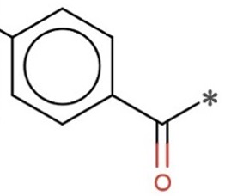
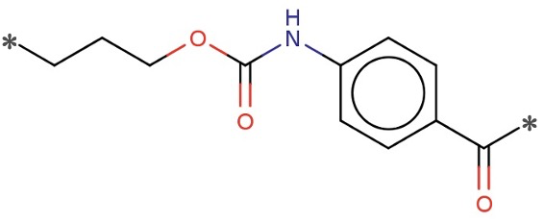
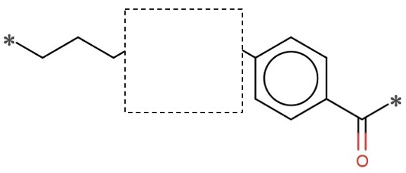
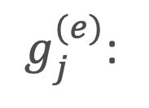
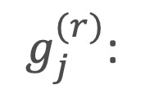
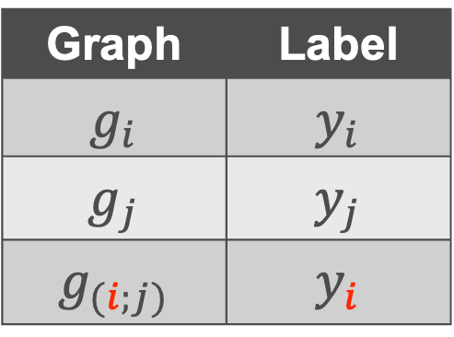
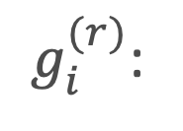
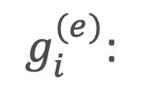
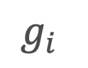
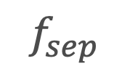
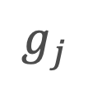
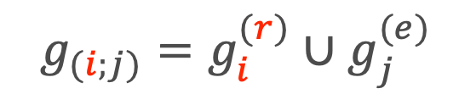
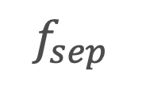
GREA: Graph Rationale/Environment-based Augmentation
$$f_{sep}$$
$g_{i}^{(r)}$:
Augmentation by Environment Replacement
$g_{i}^{(e)}$:
$g_{(i;j)}=g_{i}^{(r)}∪g_{j}^{(e)}$
$$g_{i}$$
Graph | Label
$$g_{i}$$ | $$y_{i}$$
$$g_{j}$$ | $$y_{j}$$
$$g_{(i;j)}$$ | $$y_{i}$$
$$f_{sep}$$
$g_{j}^{(r)}$:
$g_{j}^{(e)}$:
$$g_{j}$$

Slide 13
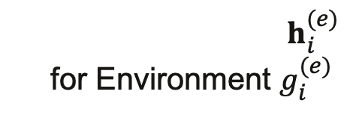
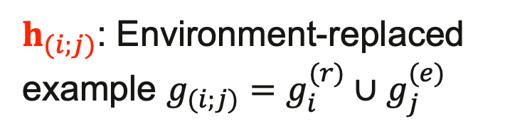
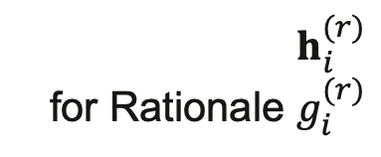
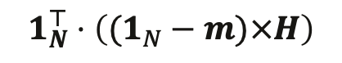
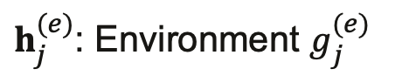
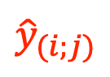
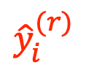






Augmentation in Latent Space
Explicit subgraph decoding and encoding is technically challenging!
$$1_{N}^{⊤}⋅\left(m×H\right)$$
MLP₂(·)
$${\hat{y}}_{i}^{(r)}$$
Label $y_{i}$
GNN₁(·)
MLP₁(·)
…
$$h_{i}^{(r)}$$
for Rationale $g_{i}^{(r)}$
$m$: Node’s probability of being classified into Rationale
Graph $g_{i}$
…
AGG(·, ·)
MLP₂(·)
$${\hat{y}}_{(i;j)}$$
GNN₂(·)
$$1_{N}^{⊤}⋅\left((1_{N}−m)×H\right)$$
$$h_{i}^{(e)}$$
for Environment $g_{i}^{(e)}$
$H$: Node representations
$h_{(i;j)}$: Environment-replaced example $g_{(i;j)}=g_{i}^{(r)}∪g_{j}^{(e)}$
Graph $g_{j}$
…
$h_{j}^{(e)}$: Environment $g_{j}^{(e)}$
Liu, et al. "Rationalizing Graph Neural Networks with Data Augmentation." TKDD, 2024.

Slide 14




Experiments: Polymer Property Prediction (Regression)
Dataset | # Graphs | # Nodes / Graph
Graph | Graph | Mean | Max
GlassTemp | 7,174 | 36.7 | 166
MeltingTemp | 3,651 | 26.9 | 102
PolyDensity | 1,694 | 27.3 | 93
O₂Perm | 595 | 37.3 | 103
RMSE (Smaller is better) | GlassTemp | MeltingTemp | PolyDensity | O₂Perm
DIR (Wu et al. 2022) | 61.2 | 87.8 | 9.4 | 2,028
StableGNN (Fan et al. 2021) | 48.8 | 70.0 | 9.3 | 1,219
IRM (Arjovsky et al. 2019) | 46.1 | 64.2 | 9.0 | 770
U-NetsPool (Gao et al. 2021) | 44.9 | 63.4 | 10.0 | 865
SelfAttnPool (Lee et al. 2019) | 43.5 | 61.0 | 9.0 | 1,251
GREA w/o Replace | 60.6 | 64.0 | 9.0 | 1,556
GREA | 42.6 | 60.2 | 8.6 | 524
glass transition temperature (Tg)
melting temperature
The graph regression error was reduced and R² was improved on the four tasks (i.e., polymer properties).
This was developed and evaluated on GCN (Kipf and Welling 2017).
Results on GIN (Xu et al. 2019) can be found in Table 2 of the paper.
polymer density
oxygen permeability

Slide 15
Experiments: Molecule Property Prediction (Classification)
Dataset | # Graphs | # Nodes / Graph
Graph | Graph | Mean | Max
HIV | 41,127 | 25.5 | 222
ToxCast | 8,576 | 18.8 | 124
Tox21 | 7,831 | 18.6 | 132
BBBP | 2,039 | 24.1 | 132
BACE | 1,513 | 34.1 | 97
ClinTox | 1,477 | 26.2 | 136
SIDER | 1,427 | 33.6 | 492
AUC (Higher is better) | HIV | ToxCast | Tox21 | BBBP
DIR | .7466 | .5954 | .4727 | .6559
StableGNN | .7218 | .6520 | .7454 | .6552
U-NetsPool | .7527 | .6507 | .7492 | .6709
SelfAttnPool | .7733 | .6510 | .7563 | .6602
IRM | .7702 | .6599 | .7654 | .6892
GREA w/o Replace | .7377 | .6614 | .7808 | .6736
GREA | .7794 | .6662 | .7822 | .6986
AUC | BACE | ClinTox | SIDER
DIR | .6751 | .6251 | .5331
StableGNN | .6607 | .7681 | .5644
U-NetsPool | .7757 | .8450 | .6181
SelfAttnPool | .7383 | .8291 | .5718
IRM | .7947 | .8819 | .6035
GREA w/o Replace | .7655 | .8708 | .6222
GREA | .8191 | .8961 | .6316
All the datasets were from the Open Graph Benchmark (ogbg):
https://ogb.stanford.edu/docs/graphprop/

Slide 16


Take Away
Graph Rationalization and Data Augmentation
Data Augmentation can improve rationalization if labeled data are limited.
Rationalization improves accuracy and explainability of graph-level tasks.
Data Augmentation can be performed via representation vectors.

Slide 17
Parameter-Centric Transfer with Unlabeled Graphs
i.e., self-supervised learning
Knowledge from self-supervised tasks could not be aligned or even conflicting with downstream predictions.
Context prediction task: (Reconstruction) | Aromatic rings ~ Prevalent structure (Maziarka et al. 2020; Zhang et al. 2021)
Property prediction tasks: | Non-aromatic rings ~ O₂ Permeability (Liu et al. 2022)
Contrastive learning task: | (Original graph, Perturbed graph) should have similar representations / labels
Property prediction tasks: | Bioisosteric replacement: Maintain biological properties Reduce toxicity (Brown et al. 2014)

Slide 18
Data-Centric Transfer
Parameter-Centric Transfer
Adapt knowledge in unlabeled data to target tasks
Interpret transferred knowledge with observable data
Expert can evaluate and control the transfer

Slide 19


Data-Centric Transfer
Based on a Diffusion Probabilistic Model – a Generative Model on Graphs
Diffusion process
Denoising process
Sufficiency for Data Augmentation: The augmented graph $G^{′}$sufficiently preserves the label of the original graph $y$
$$\min_{L_{1}}{\max_{L_{2}}{𝔼_{G}[L_{1}\left(G^{′};G\right)+L_{2}(G^{′};y)]}}$$
Minimal Sufficiency for Data Augmentation: The sufficiency is minimal if and only if $I\left(G^{′};G\right)≤I(\overline{G};G)$, $∀\overline{G}$, where $I(;)$ is mutual information.

Slide 20

Negative impact

Slide 21

Negative impact

Slide 22








Graph Diffusion Transformer (Graph DiT)
Guide Graph Generation (Denoising Process) with Representations of Conditions
Polymer Properties
$$𝒞$$
…
Synthesizability : High Value
O2 Permeability: High Value
N2 Permeability : Low Value
Multi-Head Attention
Numerical
Categorical
Adaptive Layer Normal.
Clustering Encoding
One-Hot Encoding
MLP
Adaptive Layer Normal.
Representations of conditions
Random Noise
Guide
$G$^{(T)}
$G$^{(T-1)}
…
$G$⁽¹⁾
$G$⁽⁰⁾
$$p_{θ}(G^{(t−1)}∣G^{(t)}, 𝒞)$$

Slide 23





Inverse Polymer Design
Synth.
O2 Perm
N2 Perm
Synth.
O2 Perm
N2 Perm
Generate 30 examples per property
(90 in total)
Generate 30 examples in total
…
…
…
Ground truth:
If in,
return rank
If not in,
return 30
If not in,
return 30
…
…
…
Median across
the test set: 30
rank
rank
rank
Median=4
Median=9
Median=11

Slide 24

Torch-Molecule
https://github.com/liugangcode/torch-molecule
torch-molecule is a package under active development that facilitates molecular discovery through deep learning, featuring a user-friendly, sklearn-style interface. It includes model checkpoints for efficient deployment and molecular/polymer task. The package has three components:
Predictive Models: GCN, GIN, GREA, SGIR, IRM, DIR; SMILES-based LSTM and Transformers.
Generative Models: GraphGA, DiGress, GDSS, Graph DiT.
Representation Models: MoAMa, AttrMasking, ContextPred, EdgePred.

Slide 25


Slide 26


Bridging Communities with Textbooks
Machine Learning / AI + Materials Science
For undergraduate programs
For graduate programs
Scientific primer: “American Chemical Society (ACS)
In Focus”

Slide 27




Multimodal Large Language Models
Inverse Molecular Design with Retrosynthetic Planning [Liu et al. ICLR 2025]
LLM
Graph Modules
Llamole
“To satisfy the requirements: The molecule is a complex, aromatic compound… It is”
Benchmarking:
PubChem (158K)
MoleculeNet (492K)
ThermCond (<1K)
MSA (<1K)
ChEMBL (2.2M)
ZINC (4M)
PI1M (1M)
FFV (8K)
USPTO (3.8M)
Small Molecule
Polymeric Materials
Reaction

Slide 28

Case Study

Slide 29


Gang Liu
Foundation Models Lab
On the Academic Job Market!
Lucy Family Institute for Data & Society
The hero behind all the work in this talk.
Received IBM PhD Fellowship 2024-2025.
Multiple PhD & Postdoc positions!

Slide 30
Conclusions
Analyze data and write papers
Literature
(Data)
Wet-lab experiments
Simulations
Observations
(Data)
Data augmentation
Abstractive Knowledge ++
Text, charts, images, graphs
human intelligence
with generalization as an objective
Develop machine
learning models
Fingerprints
Random forests
Graph neural networks
Large language models
Rationalization
Data-driven Knowledge
(Model)
Generalized Abilities
(unseen instances and unseen tasks)
artificial intelligence
with generalization as an objective
Data Challenges: Narrowness and Scarcity
Model Challenges: Multimodality, Explainability, and Task generalization

Slide 31
Welcome to visit our lab!
http://www.meng-jiang.com/lab.html
https://github.com/DM2-ND
mjiang2@nd.edu
The work in this talk was supported by NSF IIS-2142827, IIS-2146761, IIS-2234058, CBET-2332270,
ONR N00014-22-1-2507, and IBM PhD Fellowship 2024.

Slide 32



Gas-separation polymer membranes
Ideal polymer material
CO₂
CH₄
CO₂
Other gas
O₂
O₂
Selectivity
Permeability
Barnett et al. (2020). Designing exceptional gas-separation polymer membranes using machine learning. Science advances, 6(20), eaaz4301.

Slide 33



Research on polymer discovery
Red points: ~700 polymeric constructs that have been measured to date (60+ years)
1991 Robeson upper bound
Blue points: “Thermally rearranged (TR) polymers, which are considered the next-generation of membrane materials because of their excellent properties”
2008 Robeson upper bound
Selectivity
Permeability
Tena et al. (2016). Claisen thermally rearranged polymers. Science Advances, 2(7), e1501859.

Slide 34

Imbalanced Label Distribution
Minorities Matter!
Ideal polymer material
500 labelled graphs
Selectivity
Selectivity
Given 1.2M unlabeled graphs, can we train GNNs with balanced data? And how?

Slide 35












Step 1: Self-Training for Imbalanced Learning
$$𝒢_{imb}$$
500
$$\{\left(G,y\right)\}$$
GNN$i$(·)
MLP$i$(·)
$$i=1,…,n$$
$$G$$
GNN$i$(·)
MLP$i$(·)
$$y±∆y$$
$$i=1,…,n$$
1.2M
Confidence: $σ=1−\frac{∆y}{\max\left(y,∆y\right)}∈[0,1]$
(data)
reverse
$$𝒢_{conf}$$
(method)
Sampling

Slide 36




Step 1: Self-Training for Imbalanced Learning
1.2M is not big enough?
Reasons:
Minorities are rarely predicted.
Predicted minorities are rarely confident.
Not balanced yet!
Unlabeled data
$${𝒢_{imb}∪𝒢}_{conf}$$
$${𝒢_{imb}∪𝒢}_{conf}$$
${𝒢_{imb}∪𝒢}_{conf}$ ${∪𝒢}_{aug}$
?
reverse
Balanced!

Slide 37












Step 2: Label-Anchored Augmentation for Balancing
Given an unpopular numeric label value, generate a molecule/polymer graph?
${𝒢_{imb}∪𝒢}_{conf}$ is too small to support a label-anchored graph generator.
$G∈{𝒢_{imb}∪𝒢}_{conf}$
GNN (·)
$$h∈ℝ^{d}$$
MLP (·)
$$y∈ℝ$$
$$H_{aug}$$
$$G∈𝒢_{aug}$$
GNN (·)
$$h$$
MLP (·)
$$\tilde{y}$$
Data Augmentation
Graph Generator

Slide 38






Step 2: Label-Anchored Augmentation for Balancing
Mixing-up graph representations for a given label value!
Given $\tilde{y}$
Given a given label value $\tilde{y}$:
1. Sample a labeled example $\left(G_{j}{{∈𝒢}_{imb}∪𝒢}_{conf},y_{j}\right)$
2. Get $h_{j}=GNN(G_{j})$
3. Sample a label interval $\left(z_{i},a_{i}\right)$
4. Constrain the sampling processes:
$\tilde{h}=$ $λ∙z_{i}+(1−λ)∙h_{j}$
s.t. $\tilde{y}=λ∙a_{i}+(1−λ)∙y_{j}$
5. Augment with $\left(\tilde{h},\tilde{y}\right)$
$i$-th label interval
$$z_{i}=mean(\left\{h\right\})$$
$$a_{i}=mean(\{y\})$$
$$1,2,3,…$$
$$…,C$$

Slide 39















Framework & Optimization
$$𝒢_{imb}$$
$$𝒢_{imb}∪𝒢_{conf}$$
$${𝒢_{imb}∪𝒢}_{conf} {∪H}_{aug}$$
$$𝒢_{unlabel}$$
$$𝒢_{conf}$$
$$H_{imb}∪H_{conf}$$
$$H_{aug}$$
$G∈{𝒢_{imb}∪𝒢}_{conf}$
GNN (·)
$$h∈ℝ^{d}$$
MLP (·)
$$y∈ℝ$$
$$h∈H_{aug}$$
MLP (·)
$$y∈ℝ$$
$$ℒ=\sum_{(G∈{𝒢_{imb}∪𝒢}_{conf},y)}{ℒ_{GNN/MLP}(G,y)}+\sum_{(h∈H_{aug} ,y)}{ℒ_{MLP}(h,y)}$$

Slide 40

Experiments: Imbalanced Graph Regression
Dataset | # Graphs | # Nodes / Graph
Graph | Graph | Mean | Max
Molecule Datasets: | 7,174 | 36.7 | 166
Lipo | 4,200 | 27.0 | 115
ESOL | 1,128 | 13.3 | 55
FreeSolv | 642 | 8.7 | 24
Polymer Datasets: | 7,174 | 36.7 | 166
MeltingTemp | 3,651 | 26.9 | 102
PolyDensity | 1,694 | 27.3 | 93
O₂Perm | 595 | 37.3 | 103
Notes:
Lipophilicity: Experimental results of octanol/water distribution coefficient (logD at pH 7.4).
ESOL: Water solubility data(log solubility in mols per litre) for common organic small molecules.
FreeSolv: Experimental and calculated hydration free energy of small molecules in water.

Slide 41
Experiments: Molecule Property Prediction
MAE (Smaller is better) | Lipo |  |  |  | ESOL |  |  |  | FreeSolv
 | All | Many- shot | Med.- shot | Few- shot | All | Many- shot | Med.- shot | Few- shot | All | Many- shot | Med.- shot | Few- shot
GIN (Xu et al. 2019) | .485 | .421 | .462 | .566 | .508 | .398 | .448 | .696 | .726 | .617 | .695 | 1.154
RankSim (Gong et al. 2022) | .475 | .388 | .438 | .587 | .501 | .389 | .443 | .689 | .779 | .764 | .674 | 1.220
BMSE (Ren et al. 2022) | .494 | .409 | .450 | .614 | .533 | .400 | .449 | .777 | .856 | .809 | .820 | 1.122
LDS (Yang et al. 2021) | .468 | .394 | .449 | .551 | .517 | .423 | .474 | .668 | .809 | .796 | .737 | 1.114
InfoGraph (Sun et al. 2020) | .499 | .421 | .471 | .596 | .561 | .475 | .466 | .776 | .933 | .830 | .913 | 1.308
GREA (Liu et al. 2022) | .487 | .391 | .434 | .626 | .497 | .396 | .456 | .652 | .642 | .541 | .570 | 1.202
SGIR | .432 | .357 | .413 | .515 | .457 | .370 | .411 | .604 | .563 | .535 | .528 | .777
Zhenqin Wu, Bharath Ramsundar, Evan N Feinberg, Joseph Gomes, Caleb Geniesse, Aneesh S Pappu, Karl Leswing, and Vijay Pande. 2018. MoleculeNet: a benchmark for molecular machine learning. Chemical science 9, 2 (2018), 513–530.

Slide 42
Experiments: Polymer Property Prediction
MAE (Smaller is better) | MeltingTemp |  |  |  | PolyDensity |  |  |  | O₂Perm
 | All | Many- shot | Med.- shot | Few- shot | All | Many- shot | Med.- shot | Few- shot | All | Many- shot | Med.- shot | Few- shot
GIN (Xu et al. 2019) | 41.8 | 35.5 | 33.0 | 54.7 | 61.2 | 63.4 | 46.6 | 72.0 | 183.5 | 6.3 | 14.6 | 464.0
RankSim (Gong et al. 2022) | 41.1 | 34.1 | 33.6 | 53.5 | 57.5 | 55.1 | 46.3 | 69.4 | 165.7 | 3.9 | 13.0 | 420.7
BMSE (Ren et al. 2022) | 42.1 | 35.8 | 34.1 | 54.5 | 61.8 | 59.1 | 48.2 | 75.9 | 190.4 | 26.4 | 27.0 | 454.3
LDS (Yang et al. 2021) | 41.6 | 35.3 | 34.5 | 53.2 | 60.1 | 60.4 | 47.0 | 71.3 | 180.0 | 6.6 | 11.8 | 456.3
InfoGraph (Sun et al. 2020) | 43.6 | 35.3 | 35.0 | 58.3 | 54.9 | 46.8 | 43.0 | 72.3 | 199.5 | 7.5 | 13.0 | 505.5
GREA (Liu et al. 2022) | 41.2 | 33.3 | 32.7 | 55.3 | 60.4 | 49.0 | 48.1 | 80.7 | 182.5 | 9.0 | 14.4 | 458.8
SGIR | 38.9 | 31.7 | 31.5 | 51.4 | 53.0 | 45.4 | 42.5 | 68.6 | 150.9 | 3.8 | 12.2 | 382.8
Gang Liu, Tong Zhao, Jiaxin Xu, Tengfei Luo, and Meng Jiang. "Graph rationalization with environment-based augmentations." In Proceedings of the 28th ACM SIGKDD Conference on Knowledge Discovery and Data Mining, pp. 1069-1078. 2022.

